Slide 1
Summit
A Next-Generation Supercomputer for CU-Boulder, CSU, and RMACC
Jonathon Anderson
jonathon.anderson@colorado.edu
www.rc.colorado.edu
Notes:
Introduce yourself.
Supercomputing at CU started 5 yrs ago with Janus. Time for a refresh, and a rethink of what capabilities the machine should be designed for.

Slide 2
Outline
Overview of project and general architecture
More details about types of compute nodes
Other hardware: Omni-Path interconnect and GPFS scratch file system
Getting the most out of Summit
Installation and availability schedule
Own a part of Summit
Questions and discussion
Notes:
Jump in with questions any time ... hope to leave time for discussion at the end.

Slide 3
Summit: UCB’s Next-Generation Supercomputer
Funded via an NSF MRI grant awarded jointly to CU-Boulder and CSU
Installed and running by fall semester 2016
Theoretical peak performance over 400 TFLOPS* (compared with about 170 for Janus)
Mix of established and cutting-edge technology
Expected 5-year useful lifetime
Principal vendor and integrator is Dell
*trillion floating point operations per second
Notes:
$2.7M combined grant award; $3.5M total purchase price; difference made up by institutional matching funds
Will be installed in CU's HPCF Provides 70M core-hours/year

Slide 4
Schedule
Late April | mini-Summit test cluster available for software builds and small-scale testing
Mid July | Summit delivered and installed in HPCF
Early August | compute/interconnect acceptance testing
October | GPFS scratch storage acceptance testing Application testing and early user access (after handoff of the cluster to CURC)
Late November | general availability
January/February | Knights Landing Phi nodes installed; condo expansion of general compute
Notes:
Installed in CU’s HPCF.
Explain delay getting to GA.

Slide 5
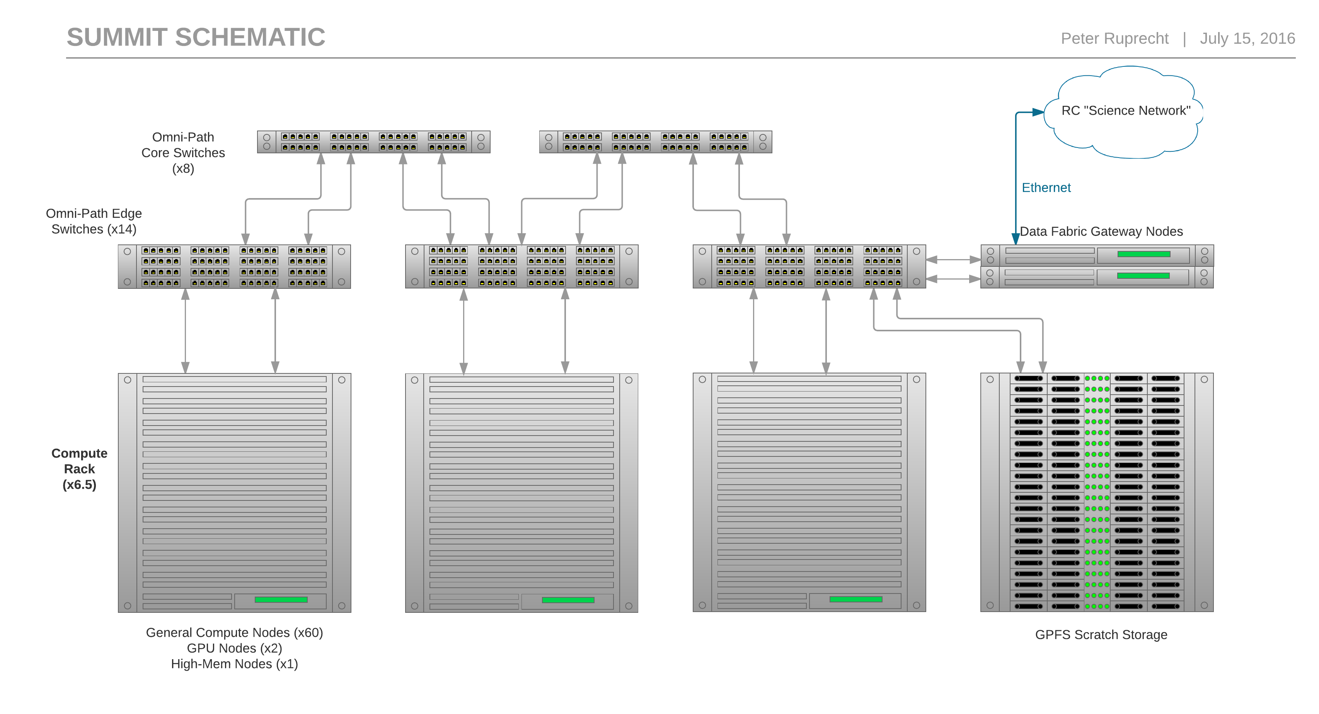
Notes:
Interconnect is what makes the cluster of compute nodes into a supercomputer

Slide 6
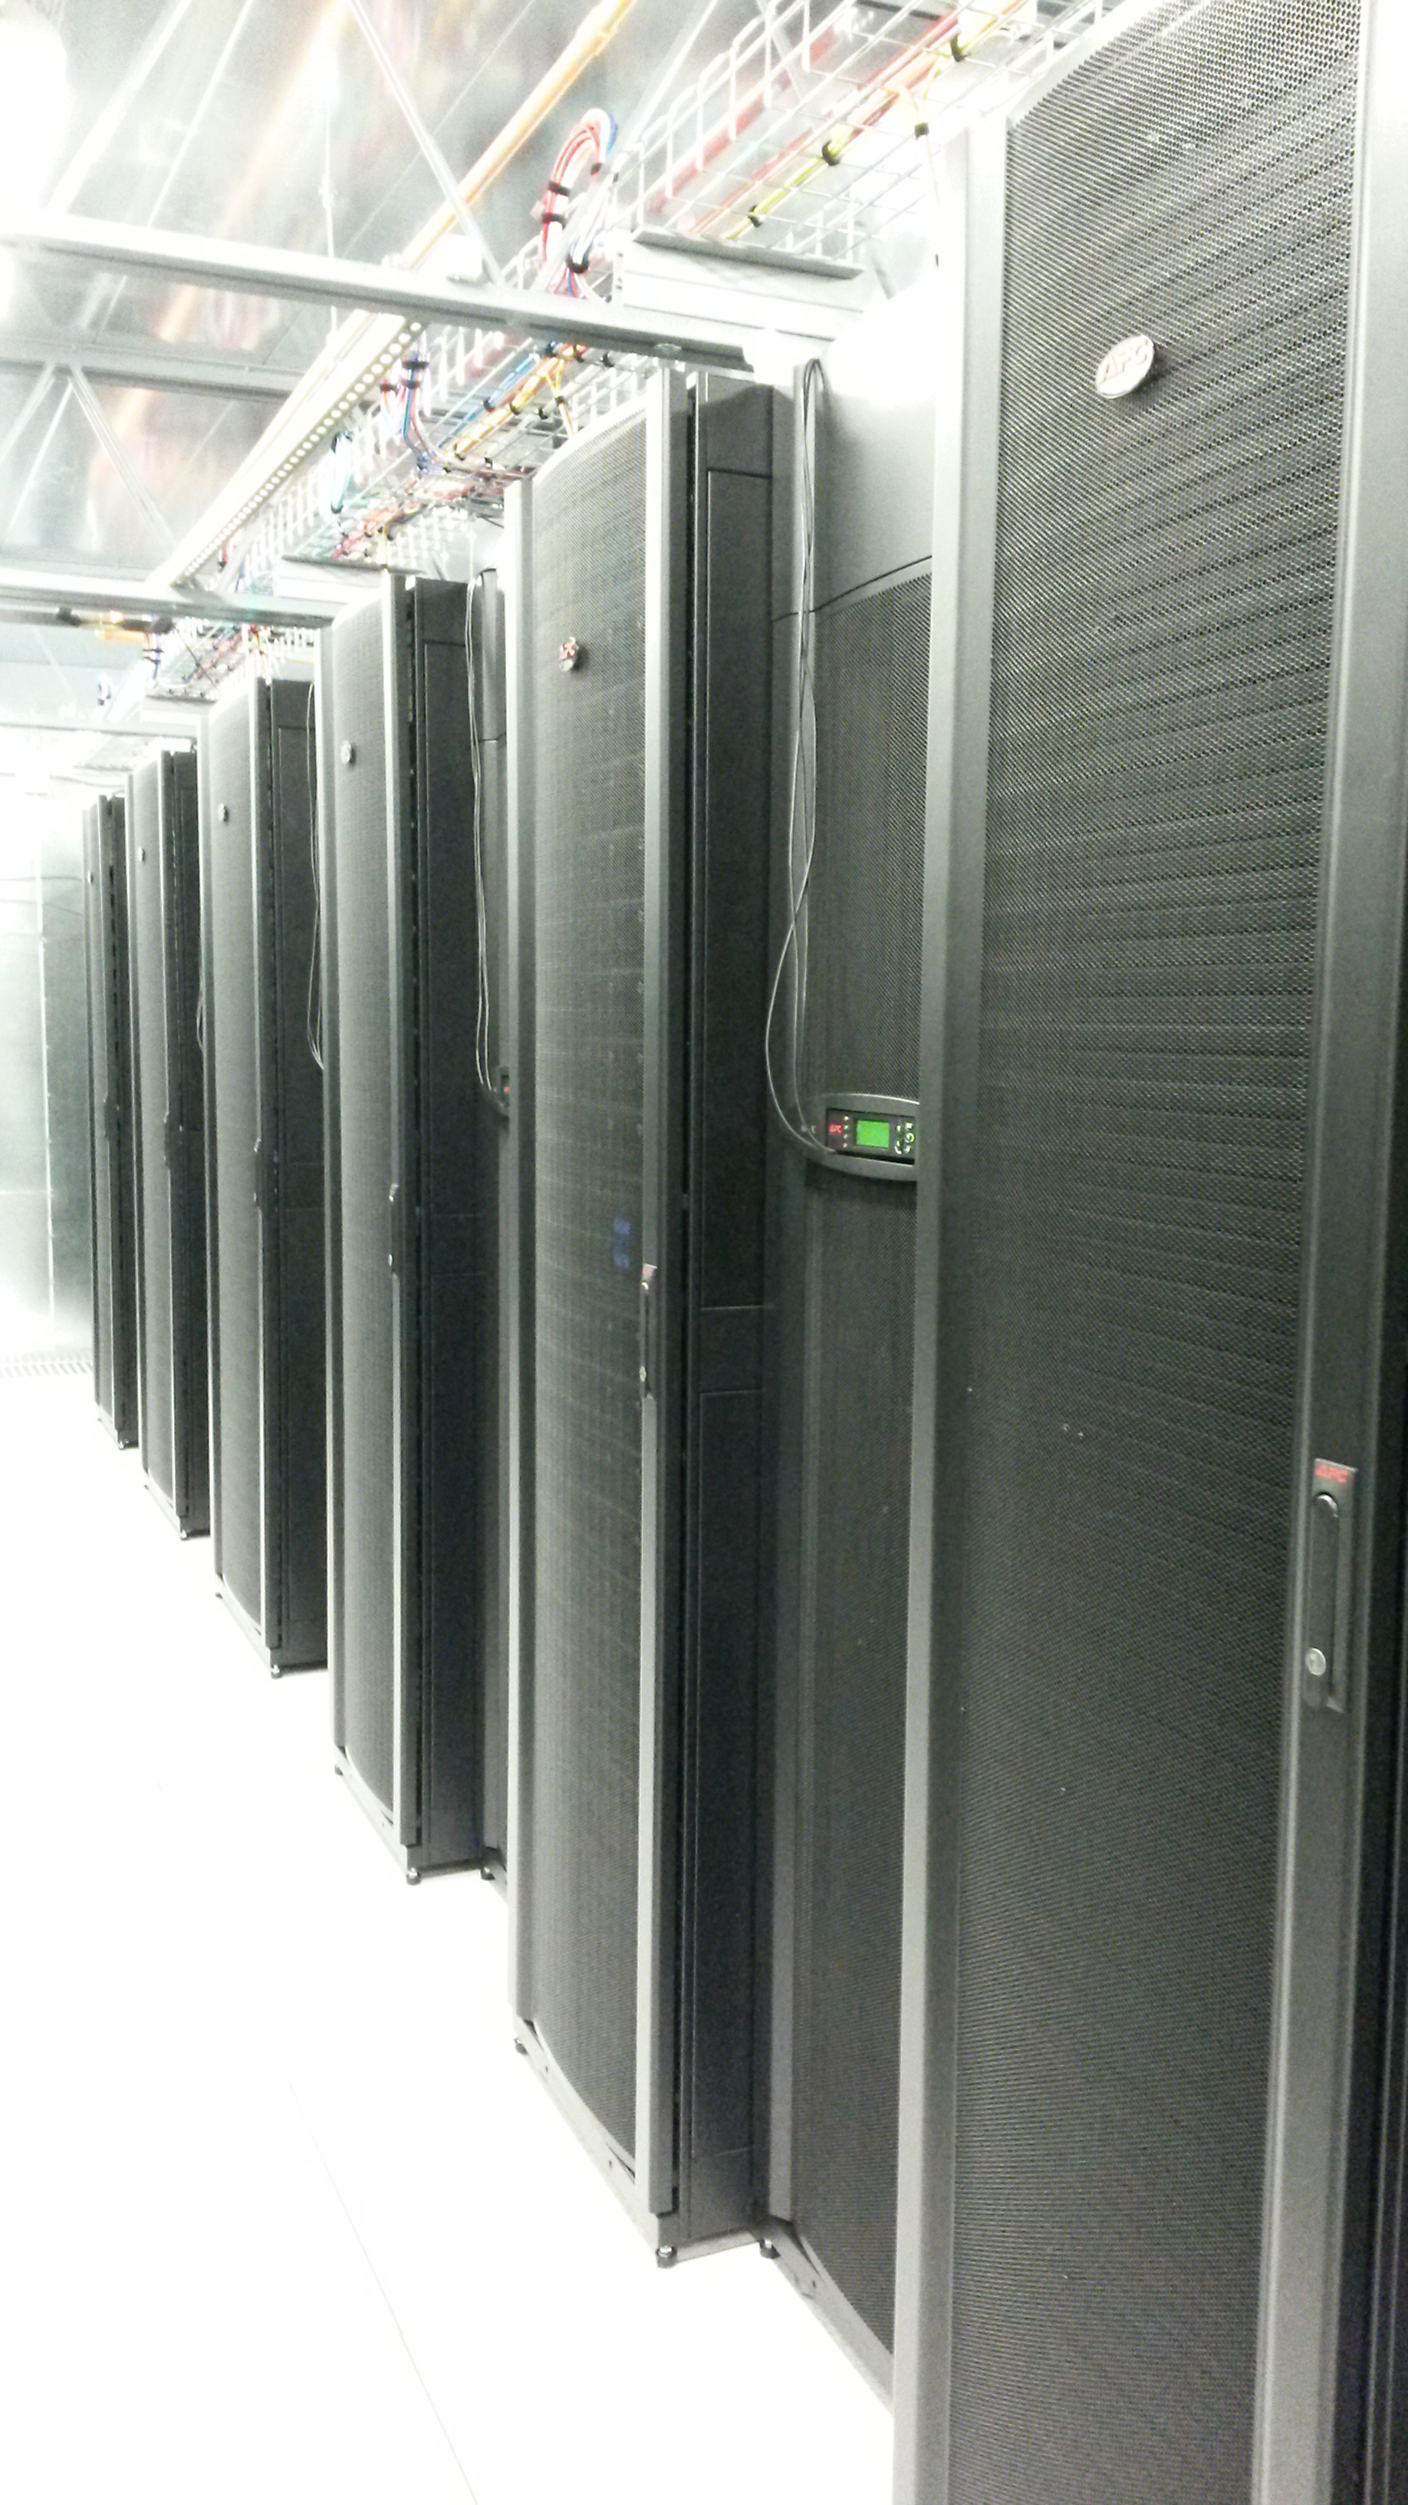
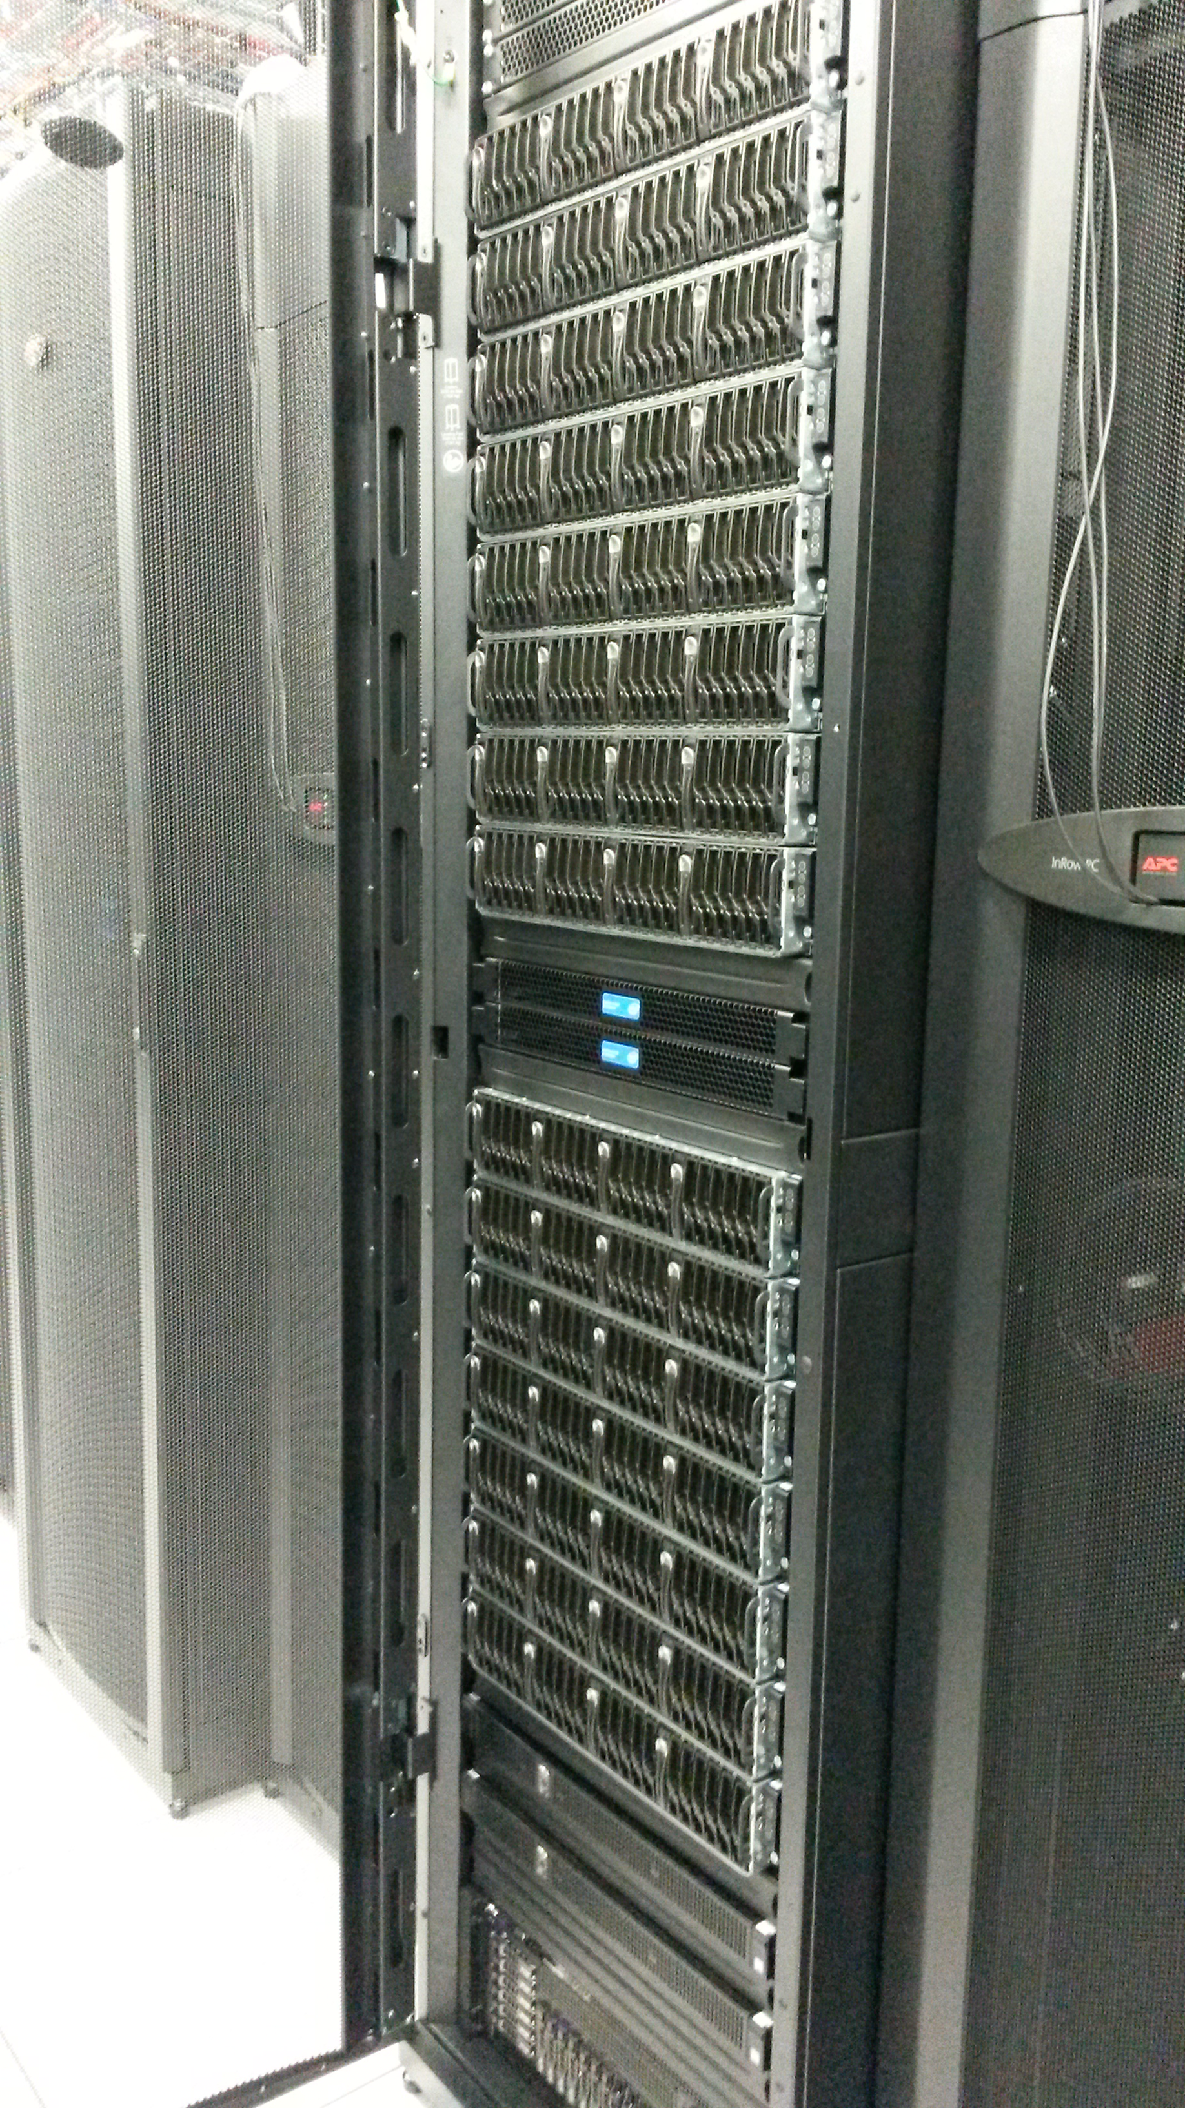
Notes:
I’m a computer guy not a photographer.

Slide 7
Summit: Node Types
380 general compute nodes
24 real cores (Intel Haswell)
128 GB RAM (5 GB/core)
local SSD
Measured performance (High-Perf. LINPACK)
.76 TFLOPS/node (average)
290 TFLOPS aggregate
280 TFLOPS 380-node HPL run (Rmax)
Notes:
Only about 1/3 as many general compute nodes as Janus but each is much more capable.
Rpeak would be 305 TFLOPS

Slide 8
Summit: Node Types
10 GPGPU/visualization nodes
24 real cores (Intel Haswell)
128 GB RAM (5 GB/core)
local SSD
2x NVIDIA K80 GPUs
Measured performance (hybrid HPL)
3.87 TFLOPS/node
38.7 TFLOPS aggregate
36.8 TFLOPS 10-node HPL run (Rmax)
Notes:
Thus with GPU, HPL is about 5x faster than general compute node

Slide 9
Summit: Node Types
5 high-memory nodes
48 real cores (Intel Haswell)
2048 GB (2TB) RAM (42 GB/core)
local SSD
12-drive local RAID
Measured performance (High-Perf. LINPACK)
1.46 TFLOPS/node
7.3 TFLOPS aggregate

Slide 10
Summit: Node Types
20 Xeon Phi (“Knights Landing”) nodes
Phi installed directly in CPU socket; not a separate accelerator card
~64 cores / ~256 threads “many core”
installed in second phase, early 2017
Expected performance (High-Perf. LINPACK)
2.67 TFLOPS/node
53.4 TFLOPS aggregate
Notes:
Phi processors are directly attached to the OPA fabric - data doesn't travel through a network card (KnL-F)
Thus total aggregate is about 390 TFLOPS

Slide 11
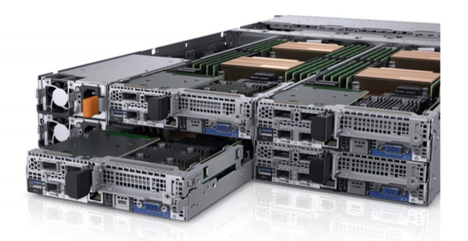
Dell C6320 Compute Node
Image: Dell.com
Notes:
4 blades in 2 rack units

Slide 12
Omni-Path (OPA) Interconnect
Cutting-edge network product from Intel
Same role as the InfiniBand fabric on Janus
Also carries NFS traffic from /home, /projects, /work ...
100 Gb/s bandwidth
Extremely low latency for MPI performance (1.5us)
"Islands" of 32 nodes fully non-blocking
2:1 blocking factor between islands
Notes:
OPA is source of delay in Summit delivery
Non-blocking: enough bandwidth that all nodes can send and receive at full speed simultaneously

Slide 13
GPFS Scratch Storage
1 PB of high-performance scratch storage
GPFS for parallel access and improved small-file performance
Directly-attached to OPA fabric (in a later update)
Expandable to about 2 PB; performance also scales up as more drives are added
DataDirect Networks SFA14K "GridScaler" appliance with embedded and external file servers
Expect >20 GB/s parallel throughput and >10K file creations per second
Notes:
SFA14K specifically designed for high performance
More on I/O performance in a bit

Slide 14
GPFS Scratch Storage
Available on login nodes and data-transfer nodes, but not on non-Summit compute nodes
Mounted as /scratch/summit
We’ll provide a way to copy data from Janus Scratch
Notes:
Parallel I/O is a multi-hour topic so I’m just waving my hands at it.

Slide 15
Summit vs Janus
Feature | Janus | Summit
CPU cores/node Clock frequency | 12 2.8 - 3.2 GHz | 24 2.5 - 3.3 GHz
RAM/core Memory bandwidth | 2 GB 32 GB/s | 5 GB 68 GB/s
Interconnect type Bandwidth Latency | QDR InfiniBand 40 Gb/s 1.2 us | Omni-Path 100 Gb/s 0.4 us
Filesystem | Lustre – optimized for large parallel transfers | GPFS – good at parallel transfers; also good at small file operations
Vectorization | SSE4 (4 operations/cycle) | AVX2 (8 operations/cycle) AVX-512 (16 ops/cycle)
Notes:
Janus was great at what it was designed for - we want Summit to be good for a wider range of needs.

Slide 16
Why Optimize for Summit ?
Summit has fewer nodes than Janus, thus we can allocate fewer core-hours (SU)
Summit is shared between CU, CSU, and RMACC, thus we can only allocate a fraction of core-hours to each
If you take advantage of Summit’s performance features, your allocation will go much farther, so
You will get more results
You will publish more papers
You will take fewer years to graduate
You will get { postdoc | awesome faculty position | tenure | Nobel prize }
Notes:
In all seriousness, Summit is an important and expensive resource that must be used efficiently.

Slide 17
Getting the most out of Summit
Any application that you have built for Janus will need to be recompiled
Applications ideally should take advantage of multi-core / many-core architectures (ie, parallelize)
Performance improvements in latest processors are mainly through more cores and SIMD* rather than faster clock speed
Applications should be parallelized and “vectorized” … otherwise Summit may seem slower than older systems
*single instruction on multiple data
Notes:
Can't increase clock frequency, so add more cores and do more work per cycle.
Generally one instruction per clock cycle.

Slide 18
Vectorization overview
Vectorizing a computation lets it take advantage of SIMD instruction sets
That is, during one CPU cycle a single CPU core can do the same operation on several data objects (8 or 16 at once in the case of Summit)
The compiler can auto-vectorize some loops; the programmer needs to write code that the compiler can easily vectorize
Some math libraries, such as Intel MKL, are fully optimized for vectorization
Many applications have vectorization built in
Matlab
Python provided by RC
Notes:
We can help you optimize your application for Summit! Training sessions in the fall, also individual consulting will be available.
Parallelization and vectorization will only be more important in the future.

Slide 19
More on Vectorization
Data register:
Consider this loop:
for (i=1 ; i<=N ; i++)
b[i] = 3 + a[i]; (inspired by Intel Autovectorization Guide)
Without vectorization:
With vectorization:
data 1
data 2
data 3
data 4
3 + a[1]
not used
not used
not used
3 + a[1]
3 + a[2]
3 + a[3]
3 + a[4]
Notes:
Vectorization allows the compiler to set up multiple operations in a single instruction
This simple example is called “loop unrolling”

Slide 20
Enabling Vectorization
Set appropriate compiler flag
-march=core-avx2
-vec-report or -qopt-report
Loop requirements:
Exit from loop must not be data-dependent, i.e. loop trip count must be known at runtime
No branching within the loop (if-statements allowed in some cases)
No function calls within the loop (except intrinsic math functions that are vectorized)
Align data on register boundaries
Be careful with C pointers (try -restrict flag)
Give the compiler hints whenever possible
Notes:
I am not a programmer. Assuming Intel compiler here.
Hints can be given via C pragmas, for example
This is just scratching the surface. Lots of great online tutorials.

Slide 21
I/O Optimization
Total Job Time = Computational Time
+ Communication Time + I/O time
Thus, optimizing and parallelizing I/O can be important
Parallel access requires special programming constructs or libraries, such as MPI-IO
MPI-IO consists of MPI functions for data reading and writing
Each MPI process can read or write a portion of a shared file
Structured data formats such as HDF5 can help a lot
Notes:
A lot of the work is done for you; use specialized I/O libraries to save yourself low-level programming.

Slide 22
More on I/O Optimization
Put no more than 10K files in a single directory
Use a structure of subdirectories for holding >10K files
Avoid metadata intensive operations like ls -l
When programming:
If a file only needs to be read, open it read-only
Do not open and close files too frequently
Assign a subset of cores for handing I/O
Give MPI-IO “hints” about how your I/O operations should be tuned
Notes:
RC will provide detailed documentation about how to optimize for GPFS once we have had a chance to experiment with the Summit scratch filesystem

Slide 23
Other New Features w/Summit
OS is RedHat Enterprise Linux 7 (vs RHEL6 on Janus)
RC login nodes will also be updated to RHEL7
Slurm job scheduler will have some new features
Different QoS and partition names
Job requests must provide more detail
Allowing shared nodes, for single-core jobs
Allocations will be provided as shares rather than “credit limits”; you’ll get higher queue priority if you have a larger share
Running on different node types will “cost” different amounts
Notes:
Jobs should request both a partition and a QoS (see next slide); also, default wall times will be shorter than max wall times for scheduling efficiency
Won’t need to load a Slurm module

Slide 24
Partition: defines type of node QoS: defines type of access
Partition | Node type | Max Wall Time | Default Wall Time | SU scaling factor
shas | General compute (Haswell) | 24 hr | 4 hr | 1
sgpu | GPU-enabled | 24 hr | 4 hr | 2.5
smem | High-memory | 7 day | 24 hr | 6
sknl | Phi (Knights Landing) | 24 hr | 4 hr | 0.1
QoS | QoS Time Limit | Priority Direction | Max Jobs/User
normal | partition max | 0 | 100s
long | 7 day | + | 10s
debug | 1 hr | + | 1
condo | 7 day | + | 100s
Notes:
QoS time limit overrides partition time limit.

Slide 25
Authentication
Two-factor auth required for ALL access
Users from CU-Boulder can use
Vasco password generator
Duo smartphone app
CSU users will
create a UCB Research Computing account via a web portal
auth using CSU’s Duo 2-factor infrastructure
RMACC users (non-UCB/CSU) will
create an XSEDE account to federate with a UCB-RC acct
auth using XSEDE’s Duo 2-factor infrastructure
Notes:
CSU Duo setup is still in progress; XSEDE integration still in progress

Slide 26
Allocations - overview
An allocation of CPU time will be required in order to run on Summit
Based on required core-hours, scaled to Service Units (SU)
Janus allocations do not carry forward to Summit
Three basic types of allocations:
General – low priority; doesn’t require a proposal
Project – higher priority based on needs and on quality of proposal
Condo – for researchers who buy Summit nodes; no proposal required
Notes:
General – same idea as the Janus startup allocation: build and test your application, initial production runs, preparation for Project proposal

Slide 27
Allocations – how to apply
Watch for announcement of proposal portal
Apply for access to General allocation first; use that for testing to inform a Project allocation application
Project allocations proposals will be evaluated by a committee
All Project proposals will require a computational plan
Larger proposals require more details
We can provide help and examples
RC is moving toward a collaborative proposal development process
Notes:
Joel can chime in about the process if there’s time

Slide 28
Allocations - implementation
Fairshare:
Slurm scheduler’s “fairshare” setting will be configured with a target number of core-hours for each allocation
This number corresponds to the number of core-hours awarded
Slurm changes each job’s queue priority in an attempt to reach the target
Lower recent usage implies a priority boost
Higher recent usage results in reduced priority in order to allow other projects to reach their targets
Notes:
If there is no queue, your jobs can start regardless of whether you’re over your target.
14-day half-life, so any jobs run over about a month ago don’t count against your usage.

Slide 29
Allocations – fairshare tree
Root share 100%
CU-Boulder share (67.5%)
General (20% of 67.5%)
Projects (80% of 67.5%)
UCB1
UCB2 …
CSU share (22.5%)
General (20%)
Projects (80%)
CSU1
CSU2 …
RMACC share (10%)
General (20%)
Projects (80%)
RMACC1
RMACC2 …
Condo share (variable)
Condo1
Condo2 …

Slide 30
Want early access?
Benefits to being a beta tester
Your code and workflow is ready once Summit is deployed
RC staff will help you to make sure your code works well on Summit
Get a computational project done during the initial phase of Summit when it might be less busy
Requirements to become a tester
Have a well-understood code ready for deployment
We are looking for a variety of applications from different fields, including GPU-enabled apps
Tolerant to unexpected problems or changes
The high-speed network on Summit is “bleeding edge” and we may have to change things or things may not work as expected
Notes:
Benefit - you'll have all the info you need to write a large allocation request right away

Slide 31
Buying into Summit
You can own additional nodes
$8840 for a general compute node + scratch storage
$18000 for a GPU node
$38950 for a high-mem node
CU-Boulder researchers eligible for a $1800/node subsidy
Priority access to an allocation sized to what your node(s) would provide you (210K core-hours/yr for a general compute node)
Additional purchases need to be finalized by late Oct 2016
Email rc-help@colorado.edu for more info
Notes:
If your grant funding requires you to own a specific node, we can property tag it for you

Slide 32
Thank you! Questions?
CU-Boulder Research Computing
www.rc.colorado.edu rc-help@colorado.edu
Slides:
https://github.com/ResearchComputing/Final_Tutorials/
Link to tutorial feedback survey:
http://goo.gl/forms/8VidcwOhRT

Slide 33
Thank you! Questions?
CU-Boulder Research Computing
rc.colorado.edu rc-help@colorado.edu

